Slide 1


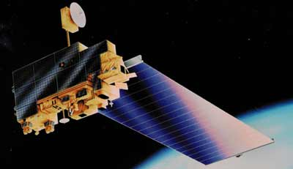


Terra-ria – A Tribute to Terra
By Aether
Dharamveer Keerti Sharma
Herman Jos L Sinchan Roy
Badrish Khanna R R Neja Fathima

Slide 2
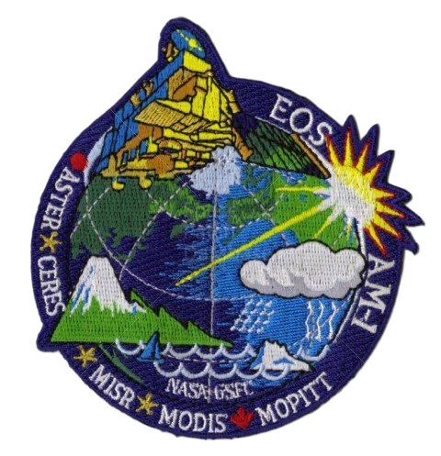
A Brief Introduction
Terra-ria is a project which aims to create a completely efficient software so that any part of the project can be accessed individually and provides useful information. Initially, we have collected the data from the NASA Sources (GIBS, EOSDIS , Giovanni etc.) and compiled them into a software which organizes data and visualizes them to a basic level. Then, the data is saved in the form of jpg or mp4 and imported to a Graphical User Interface made using Python which beautifully represents it in both 3-Dimension and 2-Dimension all the while showcasing the important images relevant to the natural calamities.
Terra has 5 instruments out of which we used 2
MODIS (Moderate Resolution Imaging Spectroradiometer) has been used to represent the information related to Cyclones, Tsunami (True Color) and Forest Fires (Band31)
MOPITT (Measurements Of Pollution In The Troposphere) has been used to represent the levels of Carbon Monoxide emissions (which is way higher when the place has a forest fire) over the world (on monthly basis).
Our work is a tribute to the Terra and the team that worked behind it. Apart from Terra being an instrument which gives us the data, it is important to note the impact the data has on us. The climatic changes has a huge impact on our lifestyle.
You might think the project name terra-ria is just an inspiration from the game terraria. However, what we really mean is Terra - Research, Impact and Awareness.

Slide 3
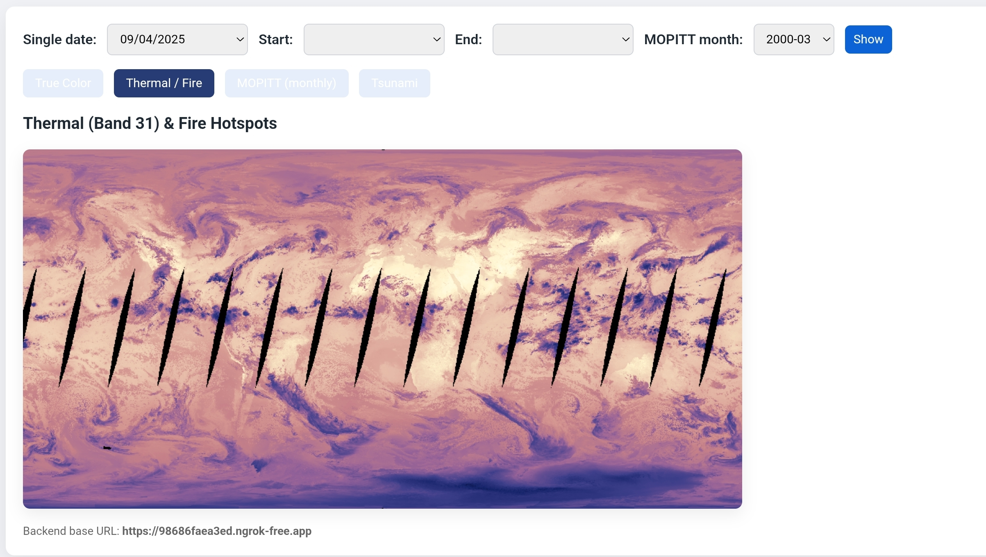
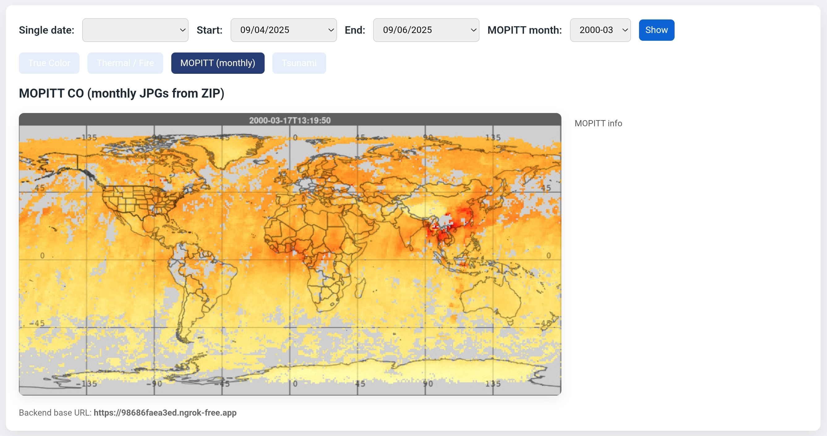
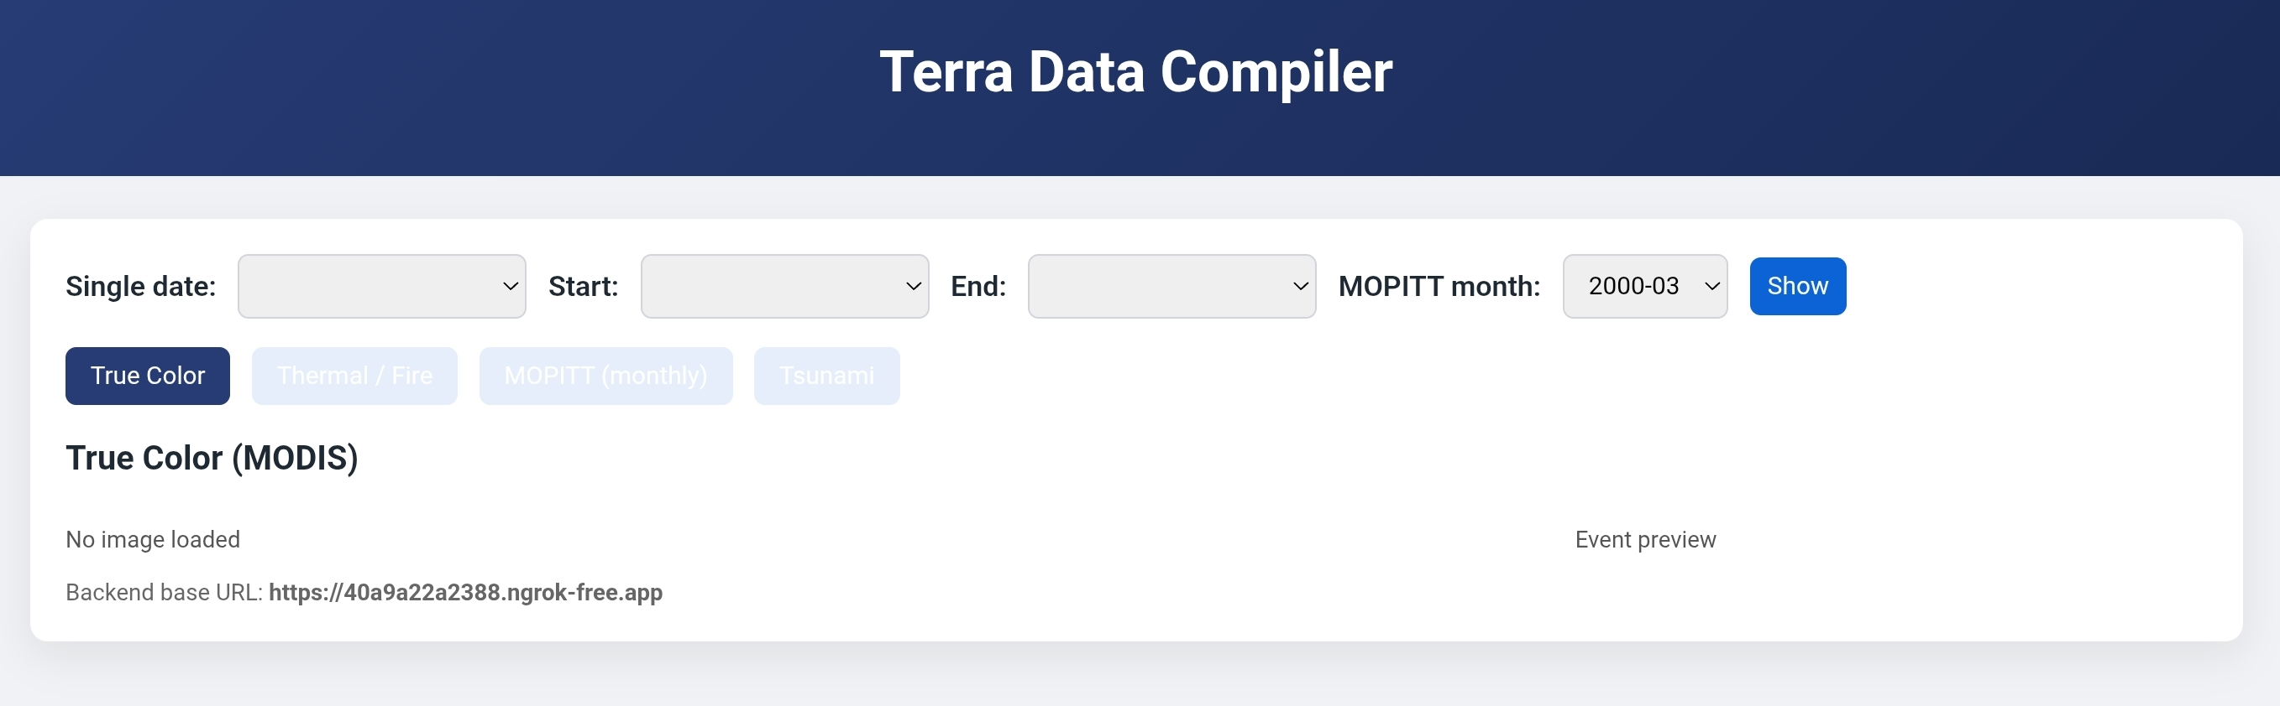
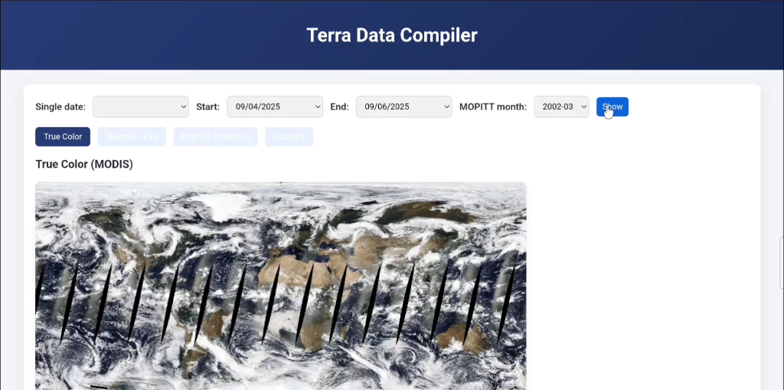
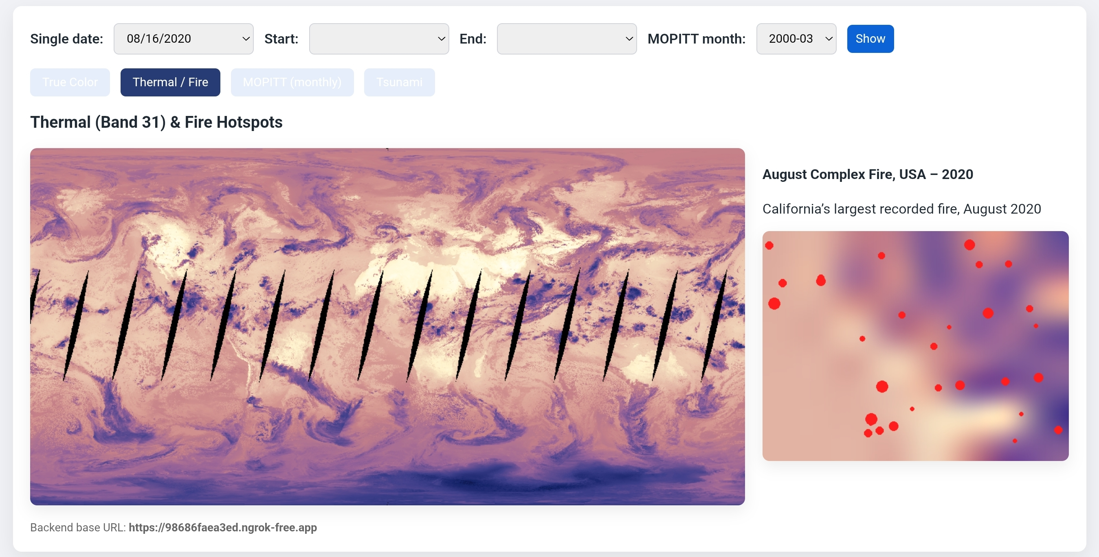
Gathering Data into our Software
The years of data collected by Terra has been thoroughly investigated and pooled into the software made by our team. In order to make sure the data isn’t randomly collected and thrown into our work, we made an organized data collector and visualizer which will do the job effectively. This has been done using Python and its libraries (and a bit of AI to avoid repetitive tasks).
Hitting a “single data” would result in the display of a single image which corresponds to the instrument’s data on that date.
MOPITT shows the CO emission over a month. More the color shifts towards the red, more the CO emission.
The data is collected through various NASA Sources,
MODIS – Data from this instrument has been collected from NASA Global Imagery Browse Services (GIBS) and has been utilized for true color and thermal imagery of the Earth. The event ( natural disaster ) metadata has been collected through NASA EOSDIS worldview. (MODIS data was used to visualize forest fires and cyclones).
MOPITT – Data from this was collected through NASA Giovanni (accessed monthly CO emission data)
We could not quite figure out how to visualize the tsunami data and thus the “Tsunami” tab in the above image is the best we could do. The interesting thing to note is that the entire software I have discussed until now has been done solely in an android device. We used the help of ngrok to create a secure public tunnel and URL so that it can be accessed by anyone with internet and an authentication token .
Giving a start date and an end date (a time frame) would result in a GIF animation of the corresponding time frame in a loop. The GIF is later saved in the form of mp4 for further access. (tap the above block to play the demonstration)
If on the single date mentioned happened a natural calamity, it shows up in the right with a short description.
Python Libraries used - flask, flask_cors, pyngrok, matplotlib, numpy, xarray, netCDF4, pillow, io, zipfile, os, datetime, imageio
These visualizations gets better in our actual visualization software. This is just a data compiler which has a visualization.

Slide 4
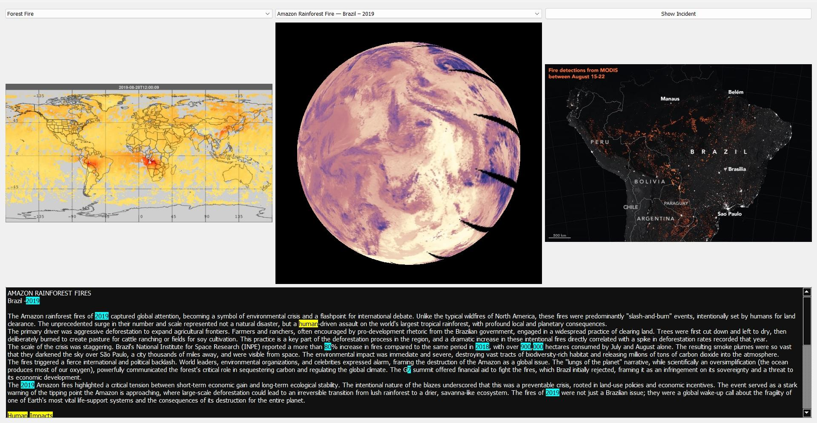
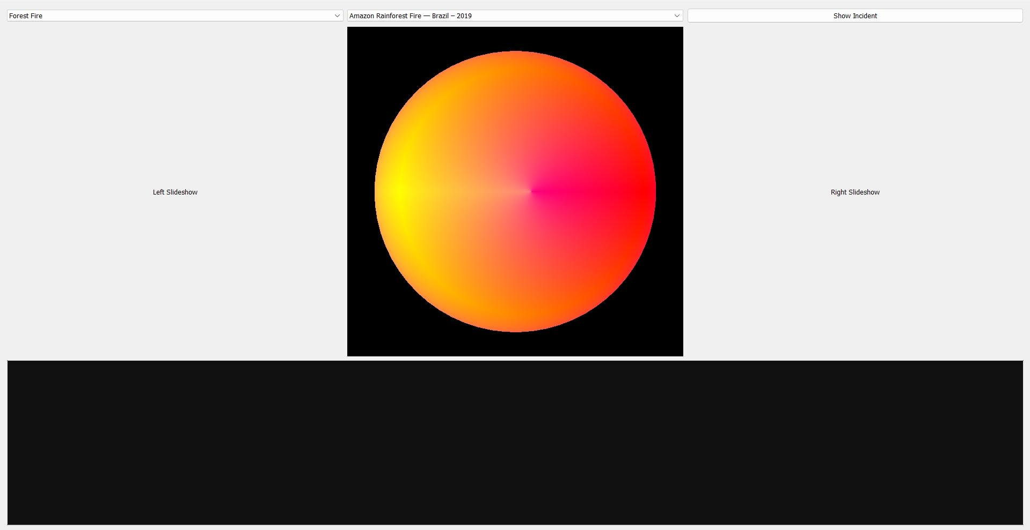
Visualizing Software
The data then has been saved in jpg or mp4 and uploaded to cloud services (Google Drive and GitHub). Instead of a website (HTML/CSS + JS), we have created a GUI for our actual visualization software.
The top left dropdown will list out the type of the calamity.
The middle dropdown will list out the event names.
Triggering the top right button will initiate the program which will fetch the files from the cloud services containing data from our data compiler and visualize it as per our choices.
The Dropdowns
Data-based 2D animations will run here. | Data-based 3D animations will run here. | Satellite images of the events will reflect here.
Description of the corresponding events.
This image shows how the software visualizes. Below is a video which shows the demonstration
https://drive.google.com/file/d/1grzFYwqBgT4MCNdGqrY8KHbBlLBjXlIp/view?usp=drivesdk

Slide 5
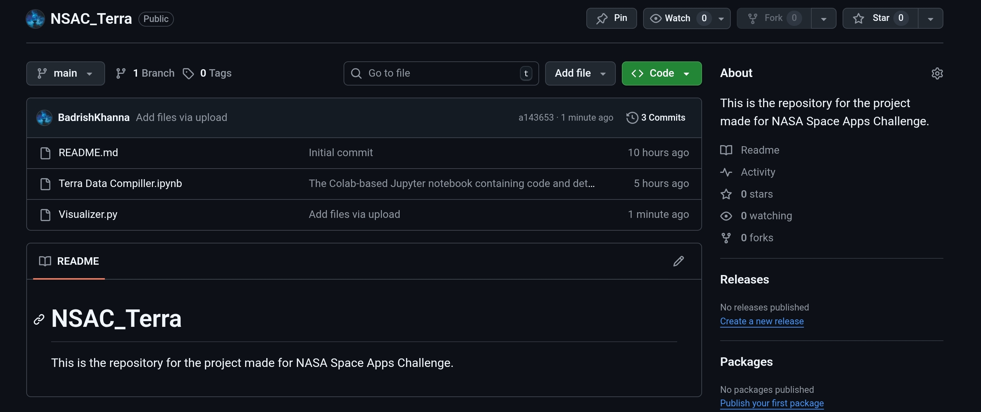
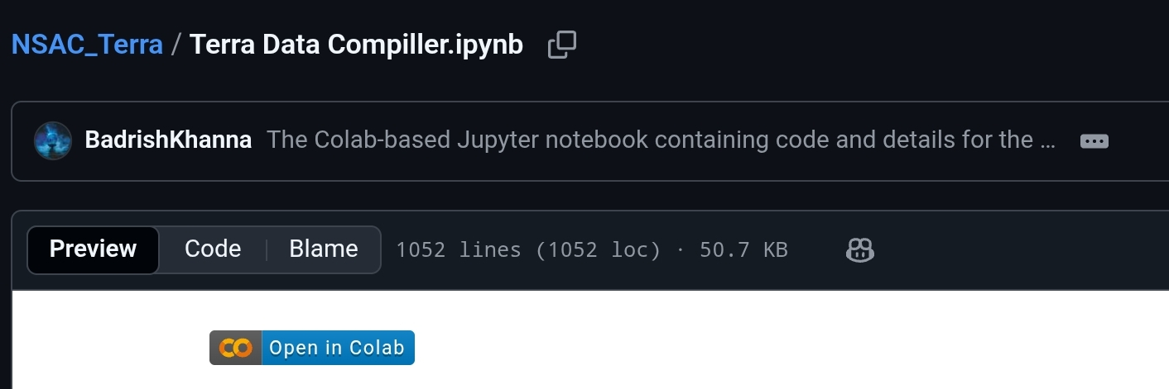
How to access and use our software?
Three cloud services are used to make this project,
ngrok ( To create a public tunnel for the terra data compiler), it is used so that the code can be done solely by an android device.
Google Drive - The image, video, zip and every other data files has been stored here.
GitHub – The final project ( for both the compiler and visualizer) as well as the final presentation/slide deck has been uploaded to this.
The GitHub has both the compiler and visualizer.
Open the google collaboratory to access the compiler

Slide 6
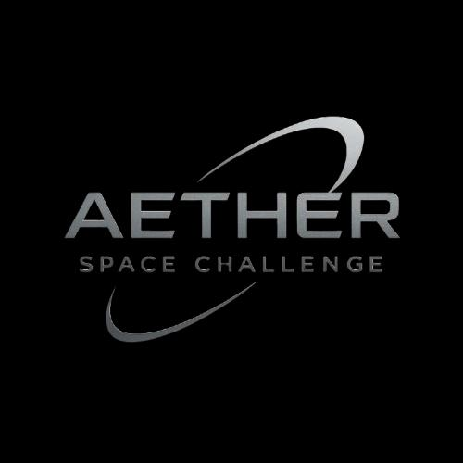
Thoughts and Conclusion
Every decade, over 3000 natural disasters take place with 400 disasters happening every year since 2020 and these numbers will not reduce but rather increase due to natural or human-induced processes. We cannot stop the natural process, however, we can reduce the ones that happen because of us. A 2025 analysis by Forbes noted that the U.S. has experienced an average of 20 billion-dollar disasters per year in the last three years, which is higher than the averages for the 2010s and 2000s.
These disasters cost us mentally, physically and economically. All that we have to know is that the work by satellites like Terra are not just data but an indication to how our future lifestyle may change. It is important for us to be aware about the changes that happen to our pale blue dot. Our team heartily congratulates Terra and wishing the team and the satellite to continue its flagship mission.

